Slide 1
1차 프로젝트 계획서
주제 : 주차 관리 시스템
개발 기간 : 2025.07.07~2025.08.05
팀원 : 안성호, 이강호, 정현성, 조현진, 최원경

Slide 2
목차
01
02
03
04
주요 기능
개발 환경 및 기술 스택
ERD / 데이터베이스 설계
시스템 구조도
04
직업 분담표
05
화면 설계
06

Slide 3
01
주요 기능

Slide 4
사용자 및 시스템 기능
원래는 차량 입차 및 출차를, 센서를 이용해야 하지만 제약이 있으므로
차량번호를 랜덤으로 생성한 뒤 주차구역에 입, 출차 할 수 있도록 할 예정.
출차 시 주차된 시간에 따라 요금 계산, 정기권을 이용하고 있는 회원에 한해서 무료로 주차장을 이용할 수 있는 기능 구현 예정.
주차되어 있는 차량을 검색할 수 있는 차량조회 기능 구현할 예정.

Slide 5
관리자 기능
관리자가 주차 현황을 확인하여 현재 주차된 차량 현황과
그 구역에 입, 출차 되었던 차량을 조회할 수 있도록 할 예정.
관리자가 주차 기록과 요금이 얼마나 나왔는지 확인 할 수 있는
주차기록조회 기능을 구현할 예정.
관리자가 주차장의 요금제를 변경할 수 있도록 하는 기능 구현 예정.
관리자가 정기권을 이용하는 회원들을 등록 및 수정, 삭제하여
관리할 수 있는 기능 구현 예정.

Slide 6
02
개발 환경 및 기술 스택

Slide 7
프로그래밍 언어 및 플랫폼 | Java 17 Spring Boot 3.5.3 (Spring Framework 기반 웹 애플리케이션 개발)
웹 관련 기술 | Spring MVC (Controller, JSP 연동) JSP (Java Server Pages) — 뷰 템플릿 JSTL (Jakarta Standard Tag Library) — JSP에서의 태그 라이브러리 (표현 및 반복 처리 등) HTML/CSS/JavaScript (jQuery) — 프론트엔드 UI 구현 및 동적 기능
서버 및 배포 | Spring Boot의 내장 Tomcat 서버를 이용한 실행 구조
데이터베이스 | Oracle Database XE (로컬 Oracle DB, SID: xe) Oracle JDBC Driver (ojdbc11) — DB 연동 드라이버
SQL 매핑 | MyBatis 3.x (MyBatis-Spring-Boot-Starter 3.0.3) XML Mapper 파일로 SQL 쿼리 작성 및 매핑
빌드 도구 | Gradle (build.gradle 사용)
기타 라이브러리 및 툴 | Lombok (getter/setter, 생성자 자동 생성 등 코드 단축)

Slide 8
03
ERD/데이터베이스 설계

Slide 9
04
시스템 구조도

Slide 10
05
직업 분담표

Slide 11
06
화면 설계

Slide 12
목차
01
Venus
02
Jupiter
Neptune
04
03

Slide 13
Main Competitors
 | Mercury | Jupiter | Venus | Neptune

Slide 14
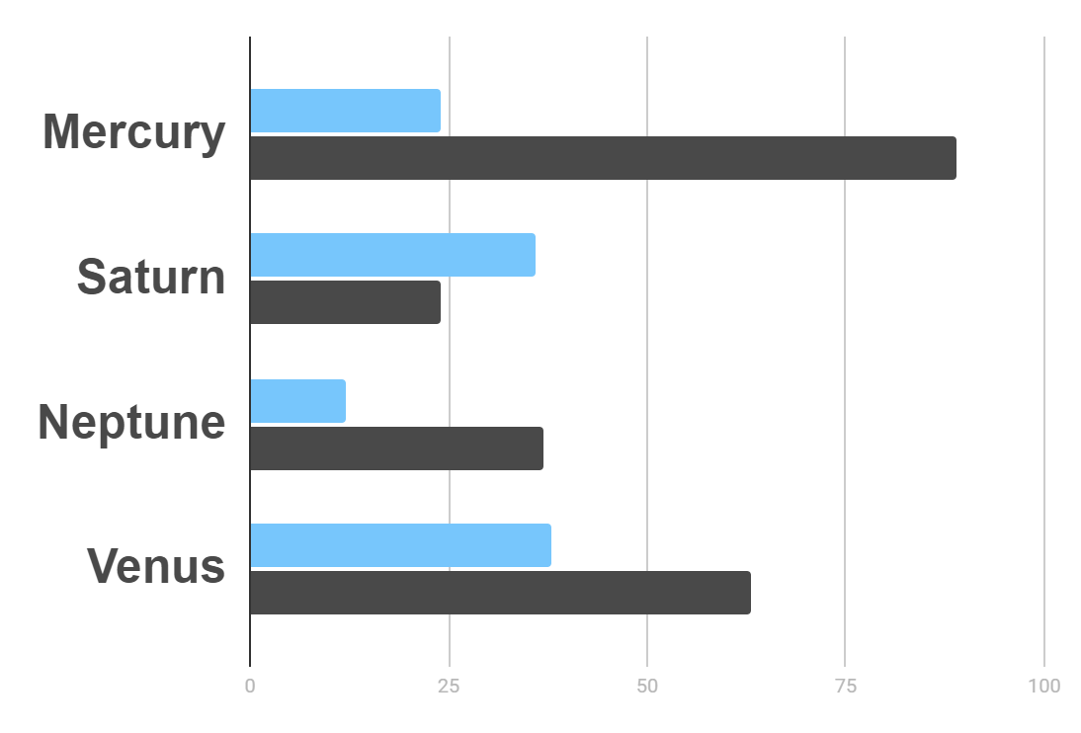
Market Research
Evolution
$20K
Gross Revenue in the Sector
10%
45K
To modify this graph, click on it, follow the link, change the data and paste the resulting graph here
Sector Growth

Slide 15

—Someone Famous
“This is a quote, words full of wisdom that someone important said and can make the reader get inspired.”

Slide 16
Awesome Words

Slide 17
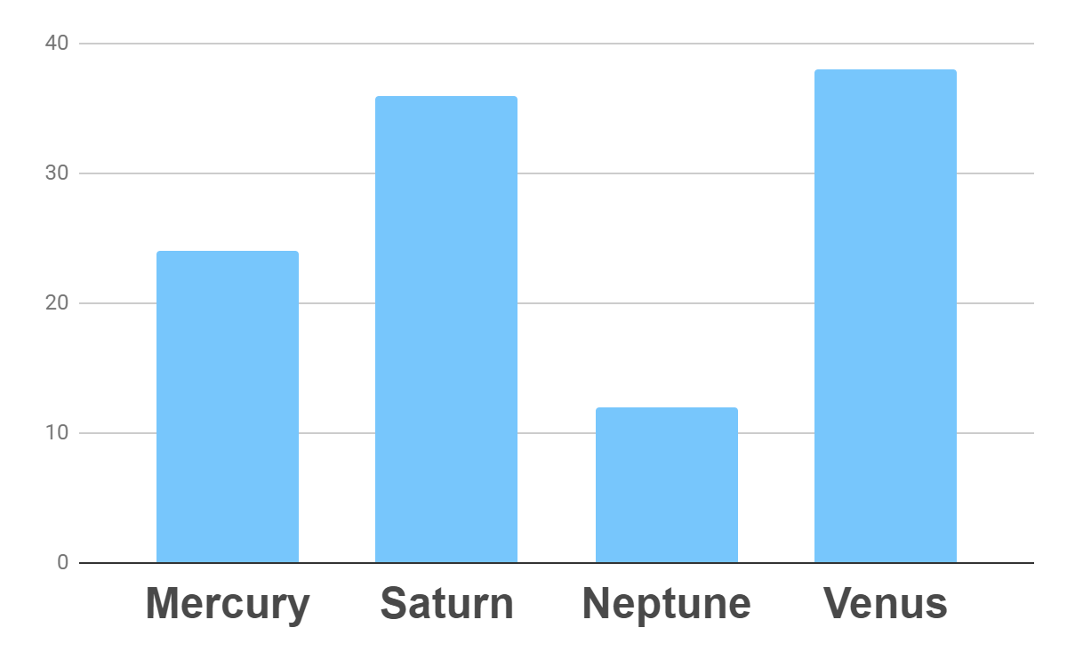
Analysis
Outreach
Top Rated Values
To modify this graph, click on it, follow the link, change the data and paste the new graph here

Slide 18
333,000.00
24h 37m 23s
386,000 km
earths is the sun’s mass
is Jupiter’s rotation period
is the distance to the Moon

Slide 19
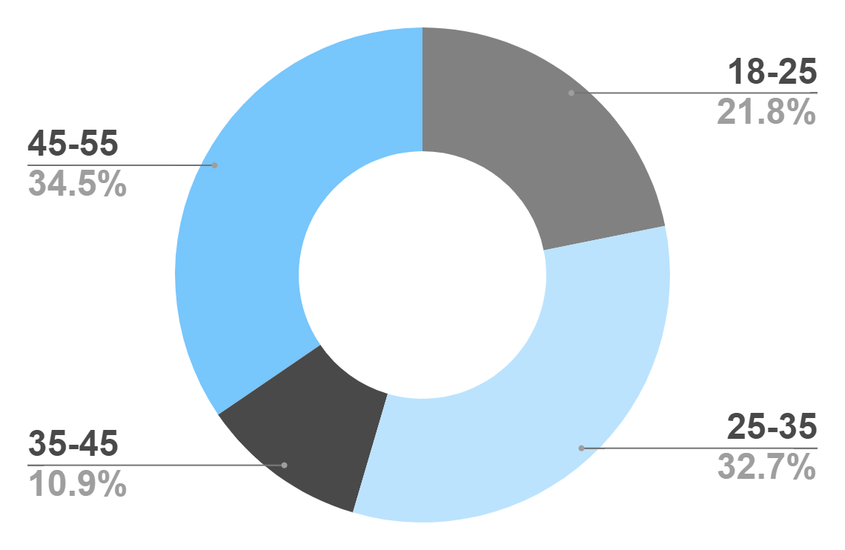
Target
Age
Gender
30%
70%
Interests
Security
Usability
To modify this graph, click on it, follow the link, change the data and paste the new graph here
Interface

Slide 20
Our Process
Mercury is the closest planet to the Sun
Venus is the second planet from the Sun
Day 1
Day 2
Day 3
Day 4
Jupiter is the biggest planet in the Solar System
Neptune is the farthest planet from the Sun

Slide 21
Whoa!
This could be the part of the presentation where you can introduce yourself, write your email…

Slide 22
Our Consultants
John James
Venus is the second planet from the Sun
Jane Patterson
Joe Doe
Mercury is the closest planet to the Sun
Neptune is the farthest planet from the Sun

Slide 23
Our Partners
Mercury
Jupiter
Neptune
Mercury is the closest planet to the Sun
Jupiter is the biggest planet of them all
Neptune is the farthest planet from the Sun
Saturn
Mars
Venus
Saturn is the ringed one and a gas giant
Despite being red, Mars is actually a cold place
Venus is the second planet from the Sun

Slide 24
Testimonials
Helena James
“Mercury is the closest planet to the Sun”
Jenna Doe
“Jupiter is the biggest planet of them all “
Mary Patterson
“Neptune is the farthest planet from the Sun”

Slide 25
Awards
Mercury
It’s the closest planet to the Sun
Venus
Venus is the second planet from the Sun
Jupiter
Jupiter is the biggest planet of them all

Slide 26
498,300,000
Big numbers catch your audience’s attention

Slide 27
Upcoming Goals
January
February
March
April
Goal 1
Phase 1
Phase 2

Slide 28
The Slide Title Goes Here!
Do you know what helps you make your point clear? Lists like this one:
They’re simple
You can organize your ideas clearly
You’ll never forget to buy milk!
And the most important thing: the audience won’t miss the point of your
presentation

Slide 29

A Picture Is Worth a Thousand Words

Slide 30
Infographics Make Your Idea
Understandable…
Mercury
Neptune
Mercury is the closest planet to the Sun
Neptune is the farthest planet from the Sun
Jupiter
Saturn
Jupiter is the biggest planet of them all
Saturn is the ringed one and a gas giant

Slide 31
…And the Same Goes for Tables
 | Mass (earths) | Diameter (earths) | Gravity (earths)
Mercury | 0.06 | 0.38 | 0.38
Mars | 0.11 | 0.53 | 0.38
Saturn | 95.2 | 9.4 | 1.16

Slide 32
Maybe You Need to Divide the Content
01
02
Neptune
Jupiter
Neptune is the farthest planet from the Sun and the fourth-largest in the Solar System
Jupiter is the biggest planet in the Solar System and the fourth-brightest one

Slide 33
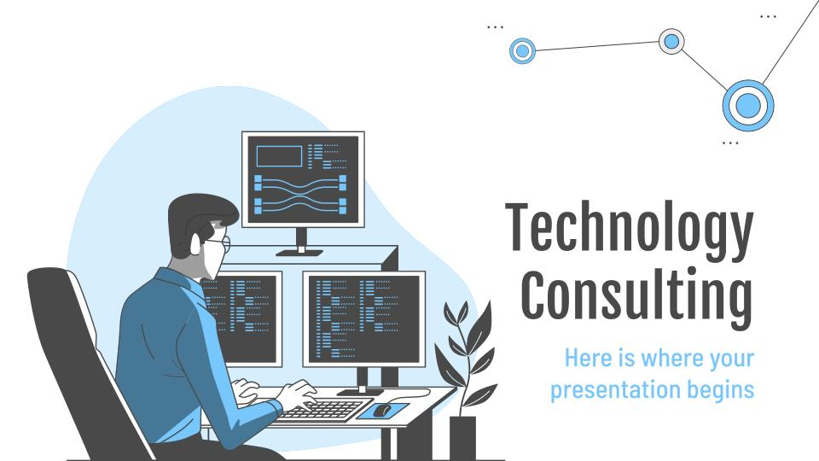
Desktop Software
You can replace the image on
the screen with your own
work. Just delete this one,
add yours and center it properly

Slide 34
Thanks!
Do you have any questions?
youremail@freepik.com
+91 620 421 838
yourcompany.com
Please keep this slide for attribution

Slide 35
Alternative Resources
Find more illustrations like these on Stories by Freepik

Slide 36
Resources
Vectors
Programming
Development
Mission impossible
Social networking
Segmentation
Site stats
Responsive
Meeting
Analysis
Cyber attack
Secure server
Control panel
Photos
Close-up of woman using a laptop
Beautiful young woman holding laptop on pink backdrop
Icons
Project Management Icon
Find more illustrations like these on Stories by Freepik

Slide 37
Instructions for use
In order to use this template, you must credit Slidesgo by keeping the Thanks slide.
You are allowed to:
- Modify this template.
- Use it for both personal and commercial projects.
You are not allowed to:
- Sublicense, sell or rent any of Slidesgo Content (or a modified version of Slidesgo Content).
- Distribute Slidesgo Content unless it has been expressly authorized by Slidesgo.
- Include Slidesgo Content in an online or offline database or file.
- Offer Slidesgo templates (or modified versions of Slidesgo templates) for download.
- Acquire the copyright of Slidesgo Content.
For more information about editing slides, please read our FAQs or visit Slidesgo School:
https://slidesgo.com/faqs and https://slidesgo.com/slidesgo-school

Slide 38
Fonts & colors used
This presentation has been made using the following fonts:
Fjalla One
(https://fonts.google.com/specimen/Fjalla+One)
Barlow Condensed
(https://fonts.google.com/specimen/Barlow+Condensed)
#494949
#477797
#77c6fc
#bbe3fe
#ddf1fe

Slide 39
Storyset
Create your Story with our illustrated concepts. Choose the style you like the most, edit its colors, pick the background and layers you want to be visible and bring them to life with the animator panel. It will boost your presentation for sure! Check out how it works.
Pana
Amico
Bro
Rafiki

Slide 40
Use our editable graphic resources...
You can easily resize these resources without losing quality. To change the color, just ungroup the resource and click on the object you want to change. Then, click on the paint bucket and select the color you want. Group the resource again when you’re done. You can also look for more infographics on Slidesgo.

Slide 43
JANUARY
FEBRUARY
MARCH
APRIL
MAY
JUNE
PHASE 1
Task 1
Task 2
PHASE 2
Task 1
Task 2
JANUARY
FEBRUARY
MARCH
APRIL
PHASE 1
Task 1
Task 2

Slide 46
...and our sets of editable icons
You can resize these icons without losing quality.
You can change the stroke and fill color; just select the icon and click on the paint bucket/pen.
In Google Slides, you can also use Flaticon’s extension, allowing you to customize and add even more icons.

Slide 47
Educational Icons
Medical Icons

Slide 48
Business Icons
Teamwork Icons

Slide 49
Help & Support Icons
Avatar Icons

Slide 50
Creative Process Icons
Performing Arts Icons

Slide 51
Nature Icons

Slide 52
SEO & Marketing Icons

Slide 53


